Slide 1
Section 5.4 Similiar Triangles
© Copyright all rights reserved to Homework depot: www.BCMath.ca

Slide 2
I) Similar Triangles
Two triangles are similar when all three corresponding angles are equal (AAA)
The Triangles will have the same shape, but can have different sizes (one is bigger or smaller than the other)
When two triangles are similar, corresponding sides will be in ratio
If you divide the corresponding sides by each other, the ratios of the fractions will also be equal:
These ratios can be used to find the length of a missing side:
Cross multiply to solve for “x”

Slide 3
Writing ratios with Similar Triangles
There are two ways to write the ratios when two triangles are “similar”.
1st method: list out all the sides from one triangle and then place the corresponding sides of the 2nd triangle next to it
2nd Method: Pick two sides from one triangle and write it as a fraction. This fraction will be equal to the ratio of the other two corresponding sides from the 2nd triangle
From 1st triangle
From 2nd triangle
From 1st triangle
From 2nd triangle

Slide 4
Q1: Given that the following triangles are similar, indicate which fraction will give the correct value for ‘x”. Then solve for “x”:
Q2: Find the lengths of the missing sides for each pair of similar triangles:

Slide 5
Q1: Given that the following triangles are similar, indicate which fraction will give the correct value for ‘x”: Then solve for “x”:
First indicate which sides are in ratio to one another:
This ratio is found in “C”
Now cross multiply this ratio to solve for “x”

Slide 6
Q2: Find the lengths of the missing sides for each pair of similar triangles and also the missing area:
Find the scale factor “k” and then “k²” to get the area of “A₂”
First indicate which sides are in ratio to one another:
The area of the smaller triangle on the left is 279.1111…..

Slide 7
Q2: Find the lengths of the missing sides for each pair of similar triangles and also the missing area:
Do this question like the previous one, find out which sides are in ratio first, then write your fractions to solve for the missing sides

Slide 8
Finding similar triangles
It can difficult to spot similar triangles when they overlap one another
One strategy is to find all the angles first and then look for triangles that share angles with the same value
Look for parallel lines that have corresponding angles:
When you have parallel lines, these angles will be equal [corresponding]
If two angles correspond and are equal, then the third angle must also be equal!
Here you can see two similar triangles where one of them is on top of the other:
The corresponding sides of these triangles will be in ratio and the fraction can be used to solve for missing sides

Slide 9
Here is another example of two overlapping triangles that are similar, but is harder to spot:
Given that the following angles are equal, can you spot where the two similar triangles are?
When two angles of each triangle are equal, then the third angle MUST also be EQUAL!!
To find similar triangles that are overlapping, find all angles that are equal to each other first, and then look for similarily

Slide 10
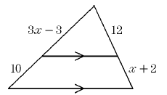
Ex: Indicate which triangles are similar to each other. Then write out the ratios and find the length of the missing sides:

Slide 11
Practice: Find the length of missing side “x”
First find which triangles are similar to each other (AAA)
Since ED and BC are parallel, you will have angles that are “corresponding” and are equal
Triangle ADE and Triangle ACB would be similar
The length of “x” is 12

Slide 12
Practice: Find the missing side “x”
Find the triangles that are similar to each other
Use these ratios to write your fractions to solve for the missing sides:

Slide 13
Ex: Solve For ‘x”
We know that from past examples that the top triangle is similar to the entire triangle.
Write the fraction and the ratio:
Given that the two lines are parallel, these angles are equal:

Slide 15
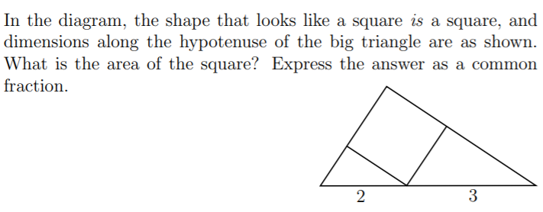
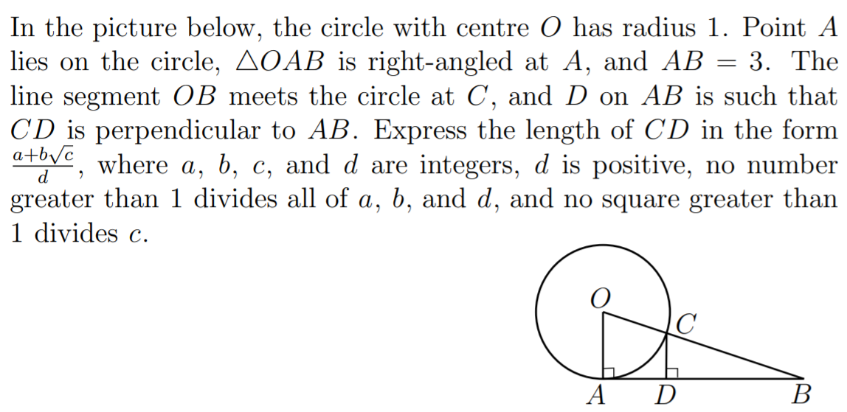
Challenge Problems with Similar Triangles:

Slide 16
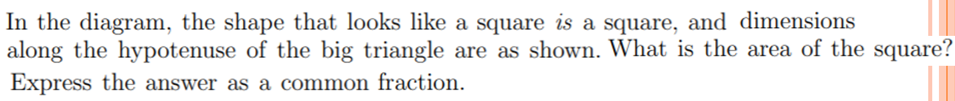
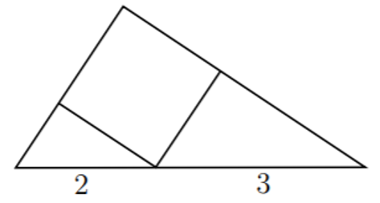
Since the shape is a square, then all four sides are equal!
Find the triangles that are similar
Find the length of the two missing sides “?” and “??” in terms of “x”
The area of the square is 36/13
Use any of the three triangles and the Pythagorean thm to solve for “x”

Slide 17
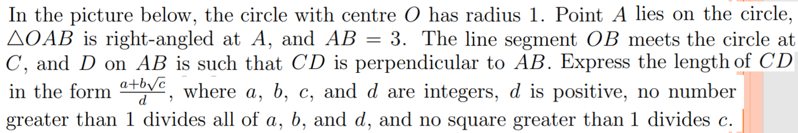
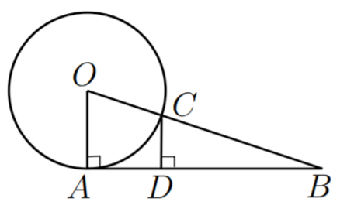

Slide 18
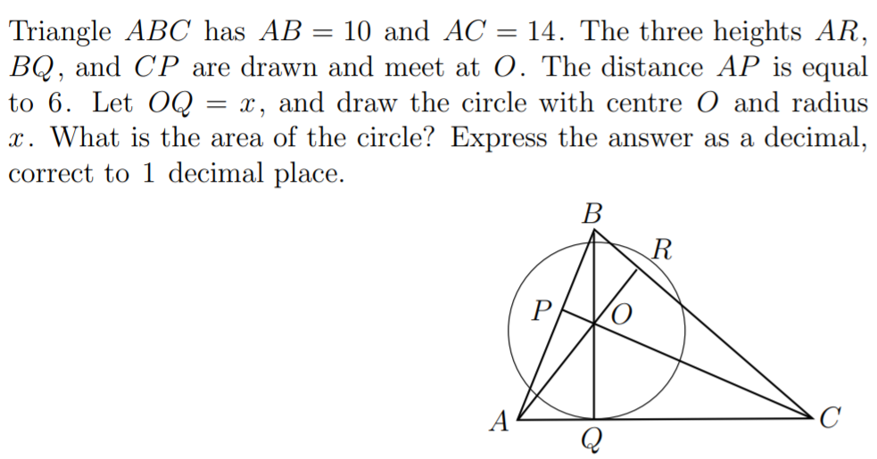
Ex: In the picture below (which is not drawn to scale), ABCD is a square of side 1 unit, and P and Q are on the line segment CD, with lines AP and BQ intersecting at X. Given that triangle ABX has area 2/5 units², what is the area of quadrilateral BCPX? Express your answer as a common fraction.

Slide 19
Ex: In the picture below (which is not drawn to scale), ABCD is a square of side 1 unit, and P and Q are on the line segment CD, with . Lines AP and BQ intersect at X. Given that triangle ABX has area 2/5 units², what is the area of quadrilateral BCPX? Express your answer as a common fraction.

